Slide 1
FA Women’s Pathway

Slide 2
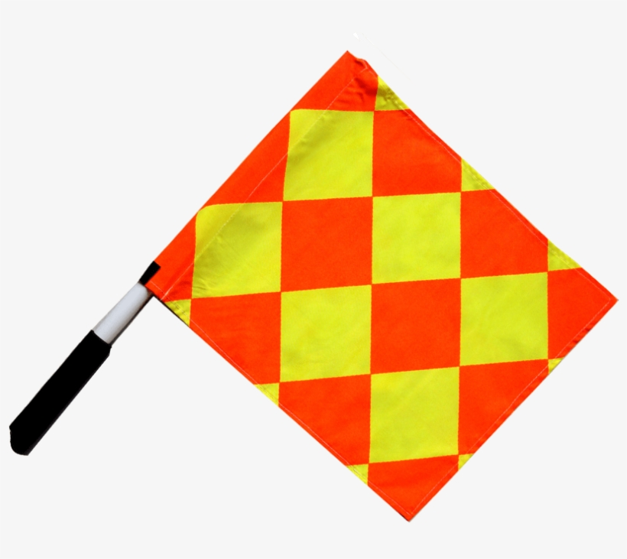
Introduction
Elle Kaplicz
3W referee
2WAR
L5M
Gee
3W
L5M
Martin
3W
L5M

Slide 3
Promotion 4W – 3W
Minimum of 1 season and/ or 20 games.
Minimum of 3 assistant referee appointments (Ideally WNL)
Minimum of 3 observations on Women’s games attaining 3 standards expected or above.
Successful completion of a laws of the game exam.
FA selection day nomination

Slide 4
Promotion pathway 3W-2W
Fitness test completion
Minimum of one season and 20 appointments in adults football (min 70% Women's football)
Minimum of 8 AR appointments
Minimum of 5 Referee appointments on the WNL
5 observations in Women's football
Successful completion of the LOTG exam
Attendance at Women's football training events

Slide 5
2WAR
Selection process
Sprints
Offside decisions
Changing direction
Flash lag
Season
Appointments are released monthly
Calendar updated at least month updated in advance
Provisional appointments
Development targets
AR coach

Slide 6
Women’s National league fixtures are released on the 23rd of each month.
Women’s Championship and Super league academy are released as provisions on the 15th of each month.
Women’s Championship fixtures are released on the Monday of each week before the fixture.

Slide 7
Assessments for 2WARS
You will be assessed each game on the following:
Key match decisions in the game (Each goal counts as one plus other scenarios)
Signalling techniques
Application and interpretation of offside
Fitness, movement and positioning
Body language
Cooperation with referee and other match officials.
Each area will be ranked as either: Serious development, advice for consideration, less, expected, better or excellent.

Slide 8
Recruitment
Email Craig Hicks and ask to be nominated for 4W-3W or 3W – 2W.

