Slide 1
FA
Grassroots
Discipline process
2026/27

Slide 2
Initial major consideration for the CFA ….
Is this a SERIOUS CASE, or not

Slide 3
If it is a serious case, then it cannot be fast tracked
Equally so if
- no report from a match official
- participant has a poor discipline record
- it is an ‘unusual’ case
e.g. Discrimination cases or major situations of disorder

Slide 4
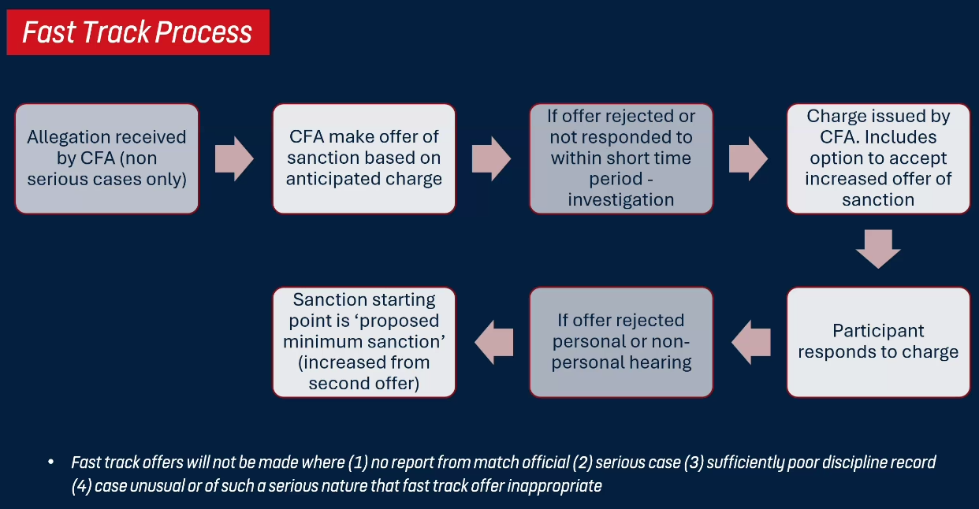

Slide 5
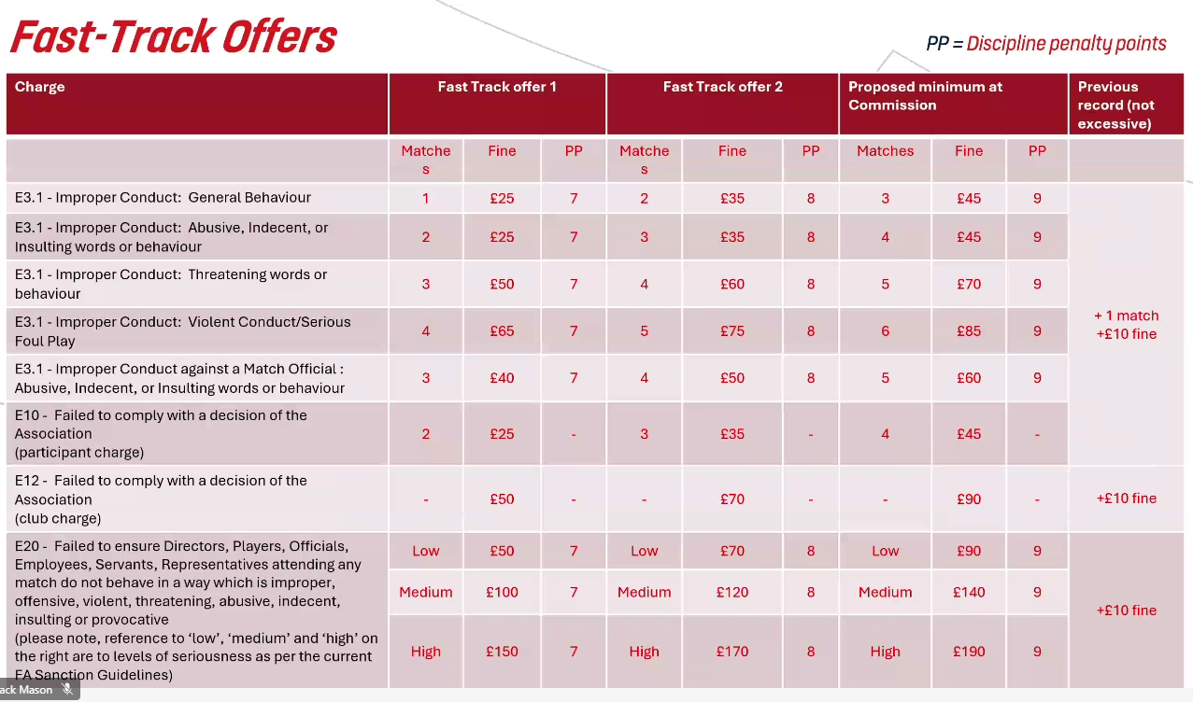

Slide 6
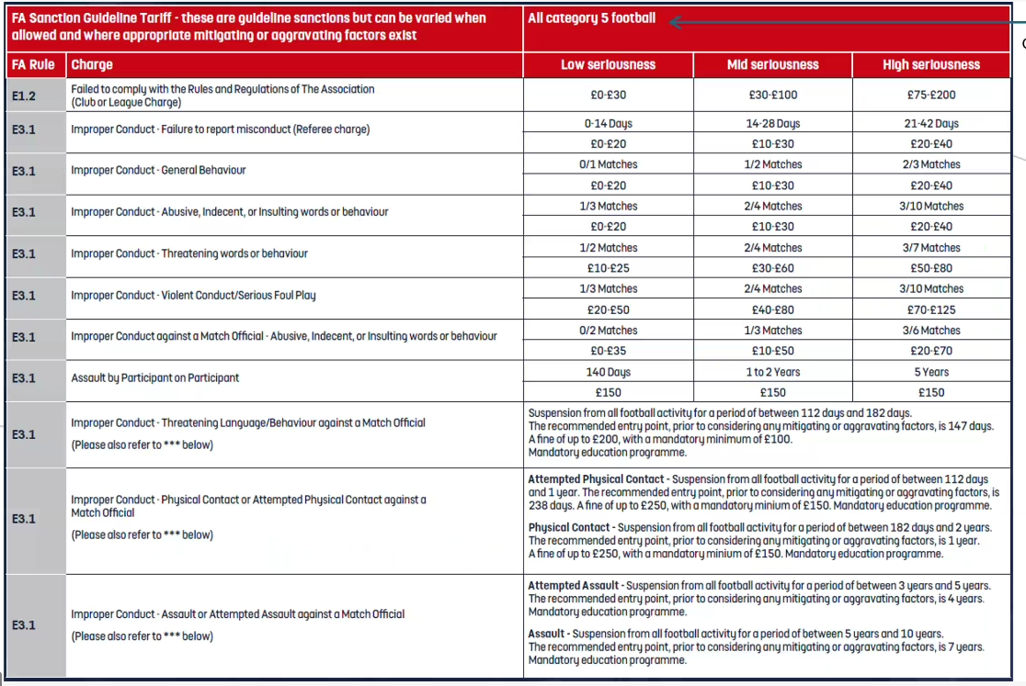

Slide 7
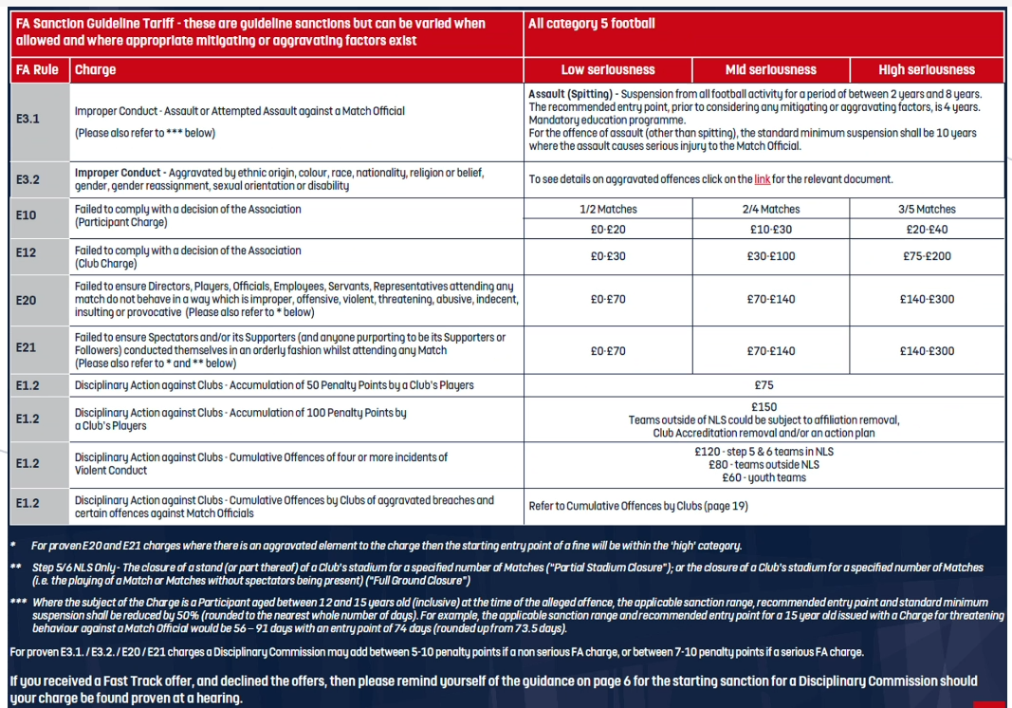

Slide 8
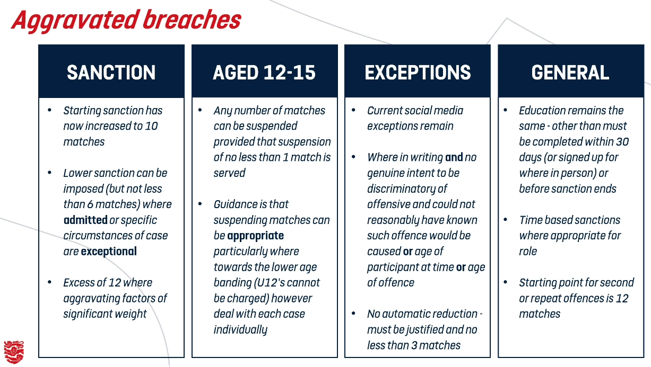

Slide 9
